Slide 1

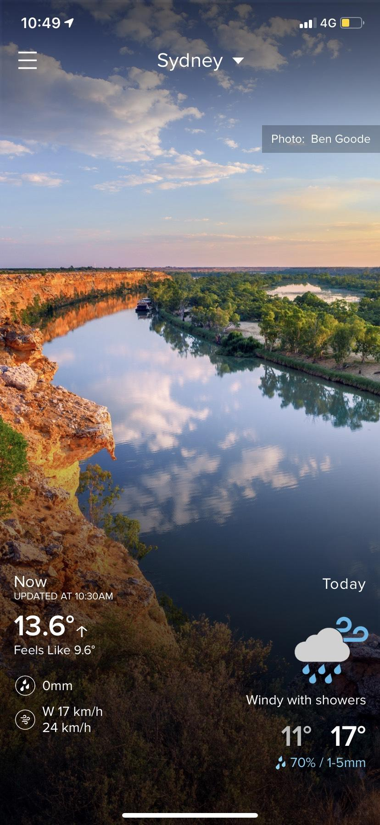




Check us out in action!
Download us in the app store.
Australia’s most comprehensive and user focused weather service
Learn www.weatherzone.com.au
mwooldridge@weatherzone.com.au
Notes:
[Introduction]
Today I am here to introduce you to Weatherzone and take you on a journey of how over the last twenty years it has grown to become Australia most comprehensive and user focused weather service.
The weather is the existential force that we all experience daily. For Australian’s it’s a large part of what makes this country great. It enables the lifestyle that we all take for granted. For all of it’s greatness however, the weather can turn, which is why you always need to be prepared and have a plan. This is where we come in.
Regardless of your weather requirements, Weatherzone delivers the right information, in a format that is accessible to the user.
It is this that has been the secret of our success and is what encourages the vast majority of our 6 million monthly weather users to check in daily.
It is this user engagement and loyalty has created a platform that offers unique advertising opportunities for brands, and if used to it’s fullest extent can leave a truly lasting impact and drive results.
***********************
Weatherzone why needs to come forward
Poem doesn’t work
Pull in the client earlier – insight slide from sales decks
How often do people think of weather
AUSTRALIA’S LARGEST PRIVATE WEATHER INFORMATION SERVICE
Stand out amongst the clouds crowd
Like sunshine on a crowded page
Mark Twain, a critic of the overblown weather clichés that appeared in so many 19th-century novels, conceded back in 1892 that weather is necessary to a narrative of human experience. Here in the 21st century, weather remains a part of our social lubrication, our identity, and it is central to how we live.
“Weather is ideally suited to the electronic age,” wrote Bernard Mergen, a professor of American Studies, in his 2008 book Weather Matters. “It’s constantly in motion, frequently fast-moving ... ubiquitous and visually beautiful.”
Australians search online for weather more than we search for sex. According to Google, “sex” was a much more popular search term than “weather’ in 2004. But by the beginning of 2017, “weather” outstripped “sex” by a ratio of four to one – a trend replicated in several other western countries.
To what extent do the climates we live in determine our interest in the weather? A team of American researchers, led by Alan E. Stewart, has tried to measure weather “salience” – the level at which we engage with the weather, and how it differs between regions. They found that people in temperate or variable climates are more likely to seek out weather information than people in dry climates. British research also points to changeable weather being a consistent theme of “weather talk”.
Advertisement
In Australia, which has as much diversity in its climate as in its population, this might help explain why Melbourne’s notoriously mercurial climate has inspired so much banter, not to mention the classic Crowded House song Four Seasons in One Day. As cricket journalist Bharat Sundaresan noted in The Indian Express, while covering the 2014–15 Australia v India Test series, “You’ll ... hardly find an Aussie who doesn’t have the weather app on his/her smartphone. Melbourne is the clear winner on this front. The city with four weathers in a day obviously has the most number of experts.”

Slide 2


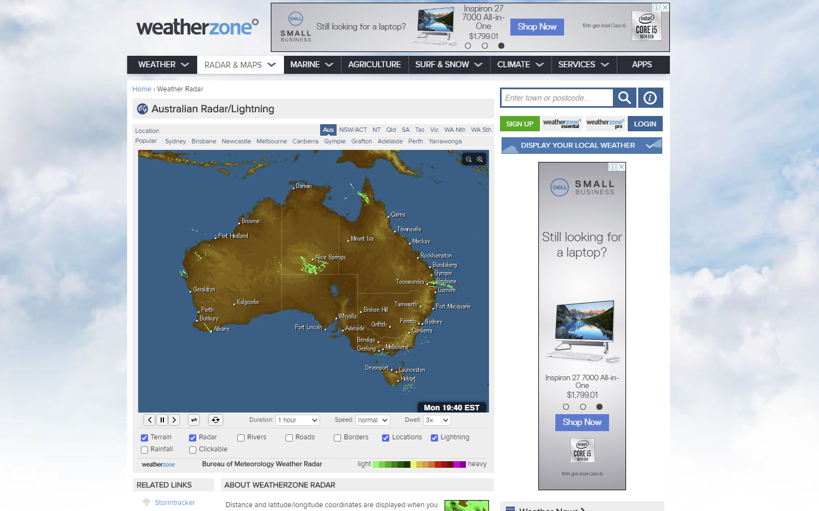

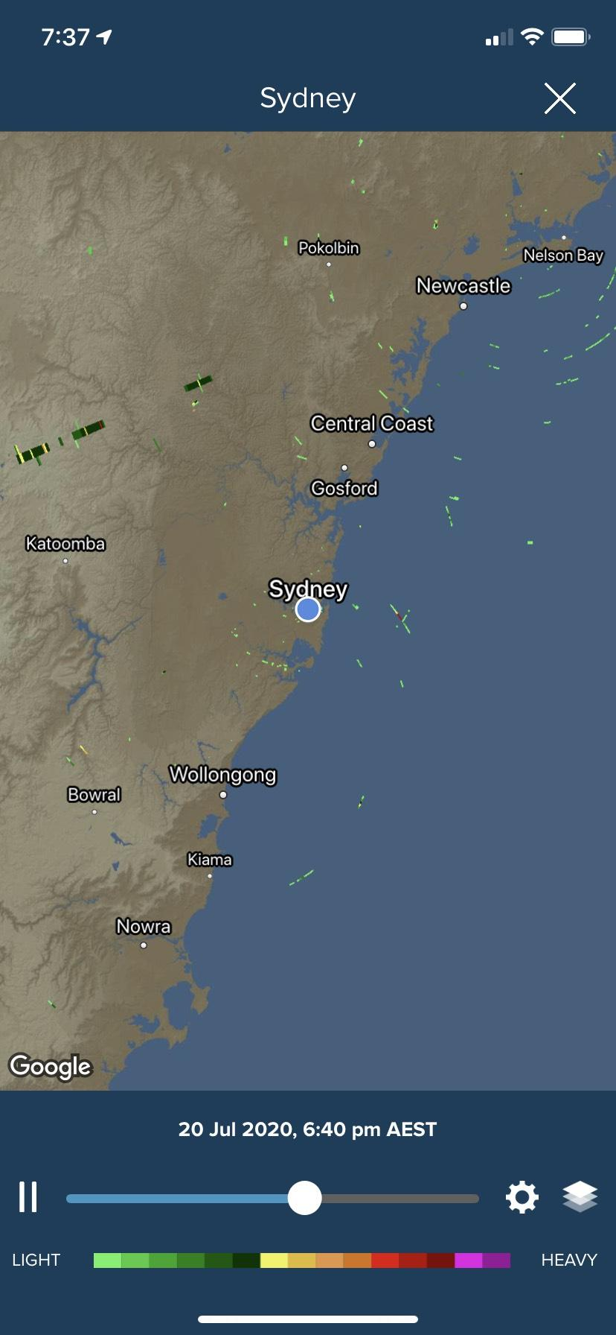


Weatherzone is the leading provider of weather services to ‘weather engaged’ Australians delivering information that is credible, insightful and tailored to each individual.
Widest data sources
That deliver an accurate and complete view of the weather as it happens
Most advanced formats and functions
Complex data displays that are easy to consume in intuitive tools
Tailored and useable information
Weather data that is customisable to the individual regardless of skill level
Trusted by major businesses
Relied on by major businesses who use Weatherzone as a critical part of their operations
Notes:
Millions of Australians regard Weatherzone as the leading provider of weather services due to the incredibly insightful and tailored weather information it provides.
Weatherzone features the widest data sources available to paint an accurate and complete view of weather as it is happening.
We use the most advanced formats and functions to take complex data displays and deliver them to users that are intuitive
This data can be customised to the individual, so each time you log on it is information that is not only uniquely Australian, but it is uniquely you.
And lastly, it is not only trusted by everyday consumers; it is also esteemed by major businesses who rely on Weatherzone as a critical part of their operations.
***********************

Slide 3


Each day, you only get one chance to make a first ad impression. Weatherzone users rise with the sun each day, checking conditions prior to them leaving the house.
800k
700k
The average person is bombarded with an average of 5,000 advertisements each day*.
With so much information delivered the brain starts screening and ignoring advertisements
600k
500k
400k
300k
Be fresh in the consumer’s mind and give your brand the best chance of being remembered by appearing right at the start of their day – before TV, before OOH and before Radio.
200k
100k
4:00
5:00
6:00
7:00
8:00
9:00
10:00
Source: Weatherzone Internal Data, Google Analytics, May 2020
Source: Forbes, “Finding Brand Success in a Digital World”*
Notes:
You’ve heard of the saying “You only get one chance to make a first impression” – for brands this is even more complicated.
The average person is bombarded with an average of 5,000 advertisements each day and what happens when the brain is overwhelmed with too much information - it starts to screen the information and ignoring messages.
Whilst checking the weather is a consistent behaviour throughout the day, we see a giant peak early in the morning. Every day, without fail a large percentage of our user base checks the weather before they leave home for the day.
This creates a unique opportunity for brands, as when paired with the ECLIPSE (and overlayed with data) you can be the first, if not one of the first messages, a user sees that day.
Fresh in their mind, before they’ve had the opportunity to see a TV ad, before they listen to the radio in the car, and long before they see their first OOH advertisement.

Slide 4




Weatherzone is the ultimate brand safe environment.
Customers are 3x less willing to associate with brands that advertise alongside unsavoury content – the power of context makes audience assume placement is intentional
There is 5x more reader attention in PGC environments than on social feeds. Higher attention translates to engagement – with content and brands.
All of our content is professionally produced, meaning that all of our pages are safe for every category.
Source: The Halo Effect: Ad environment and Receptivity May 2019
Notes:
As mentioned in the last slide, Weatherzone truly is the ultimate brand-safe environment.
We often joke internally is that the worst thing you will read about is weather news that means you have to change the plans of your day.
Importantly, what also comes with brand safety is the ability to offer the same reach as many major news publishers. With Weatherzone, you won’t ever have to worry about being a car advertiser and running up against news about a car accident, or being a financial institution and worrying about breaking news on the next finance scandal.
We all know why this is important, but the statistics support this, showing that consumers are 3x less likely to associate with a brand that appears next to unsavoury content.
Additionally, compared to UGC social environments, Weatherzone stands out as everything is professionally produced, meaning readers are 5x more engaged in our content and the brands that appear within our environments.

Slide 5
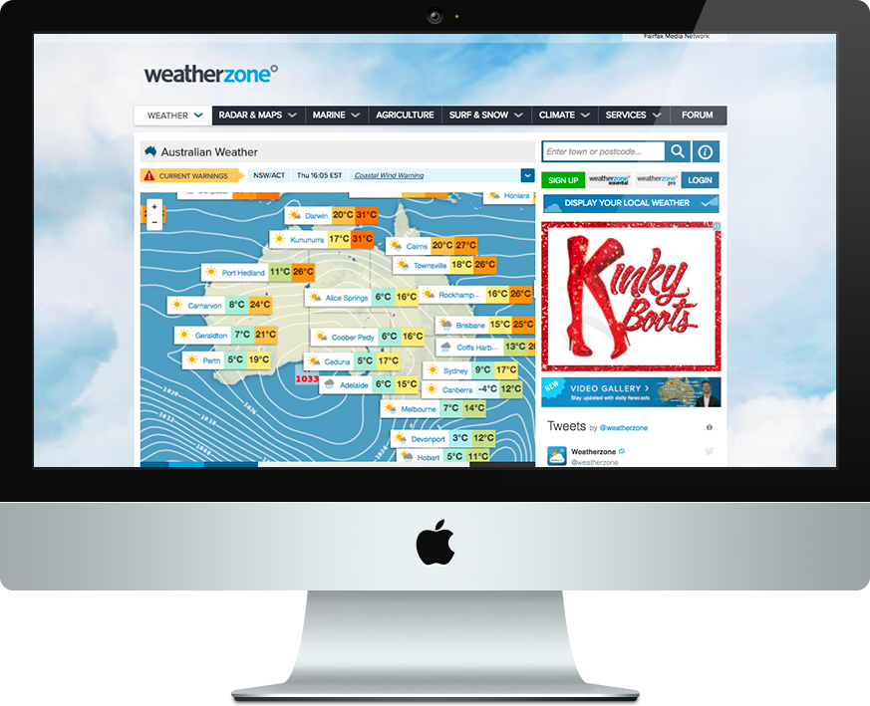
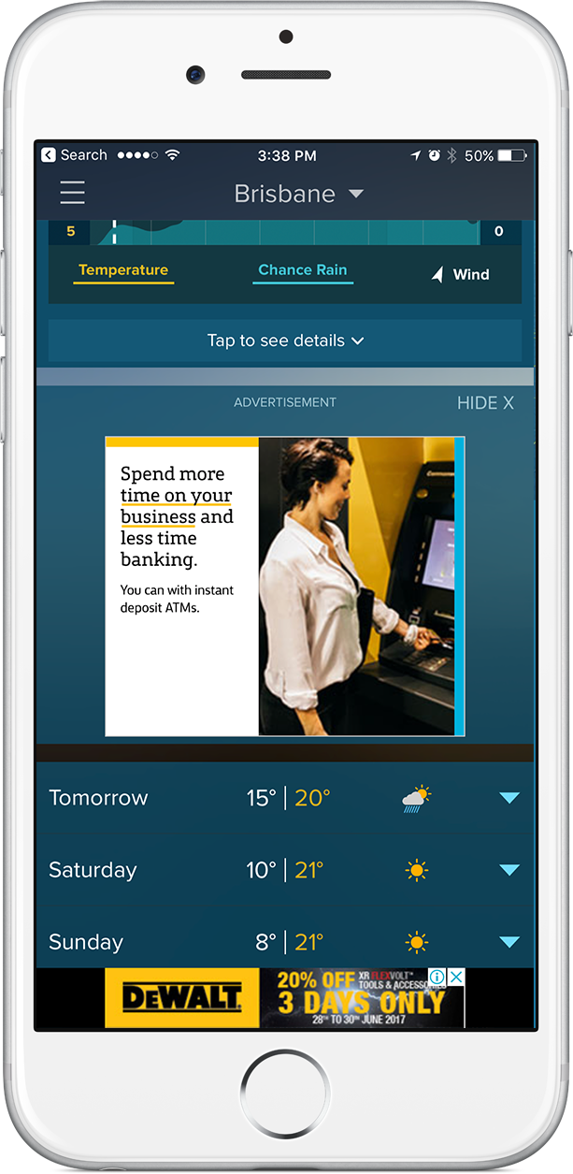

We have digital storytelling formats available for every advertiser’s message.
Standard display 728x90 | 300x250 | 970x250
Mobile display
Sticky 300x50 & 300x250
Brand safe
Brand safe
Enrich with data
High viewability
Programmatic
Enrich with data
Direct
Programmatic
$18 | $25 | $50
Market CPMs
Direct
$18 | $25
Market CPMs

Slide 6







Utilise the same data set that feeds the consumer weather experience to supercharge your brand’s advertising campaigns.
Temperature Target max temp, cold warm, hot, very hot, extreme
Location State, district, town
Conditions Today’s weather, sunny, rainy, storms, cloudy, windy, snow
Bushfire Low, high, very high, extreme, catastrophic
Pollen Low, moderate, high, very high, extreme
UV Low, moderate, high, very high, extreme
Notes:
Replace the image
Like adding the right amount of salt to a meal can enhance the dish – the same can be said of data to advertising campaign.
Temperature targeting, which you saw earlier, showed what the impact of as little as half a degree Celsius could have on the buying habits of consumers. Temperature targeting is the easiest way to get started with us and can start adding value to almost any media schedule.
Accurate location data at scale is also perfect for so many brands and if I think about how important location is when planning and buying OOH, Weatherzone is the perfect complement.
We then have conditions like rainy, windy etc. that we also know greatly influence consumers buying habits, as previously shown.
Now some really unique data sets are offerings around bushfires, pollen and UV. These are obviously valuable to government organisations for community service announcements but can also be perfect for so many more brands if you get creative. Why not pollen counts for pharmaceuticals brands with their hay fever solutions or UV Index for sunscreen or sunglasses brands?
The options are unlimited.

Slide 7




Weatherzone is a truly unique advertising platform for brands.
Weatherzone is the leading provider of weather services to ‘weather engaged’ Australians.
Studies have proven that an increase or decrease in temperature can influence buying habits for consumers.
Reach your target audience with our brand safe, high impact creative solutions that can be overlayed with data.
Extend beyond traditional advertising and integrate your brand into the wider Weatherzone consumer product and tools.
Notes:
Before I wrap this presentation, I wanted to recap and leave you with some lasting thoughts on why Weatherzone is a truly unique advertising platform for brands.
We do weather better than anyone else, and we reach an audience of loyal, passionate and engaged Australians
Studies have proven that changes in temperature can influence buying habits for consumers. If you recall, Weather is the 2nd biggest influence on consumer behaviour after the state of the economy.
We can do it all – high impact, check. Audience targeting, check. In a brand safe environment that are most people’s first stop of the day, check.
Lastly, our platform is open for integration. Help us continue to drive additional value to our users through your brands involvement.
Weatherzone is a platform that offers unique advertising opportunities for brands and if used to it’s fullest extend can leave a truly lasting impact and drive results.

Slide 8


Weatherzone Data:
Weather forecast API - clients can use this data to inform their wider media campaigns
Weatherzone can create a videos series - curating a combination of weather triggers into a Weather report
Includes shooting, editing and production. We will supply you with the raw video for use on other channels
This is bespoke forecast data by an experience meteorologist - HUGE, UNRIVALLED CREDIBILITY
Notes:
Engage consumers during their morning routine
The media strategy will focus on embedding our media across a customer’s morning rituals

